Slide 2
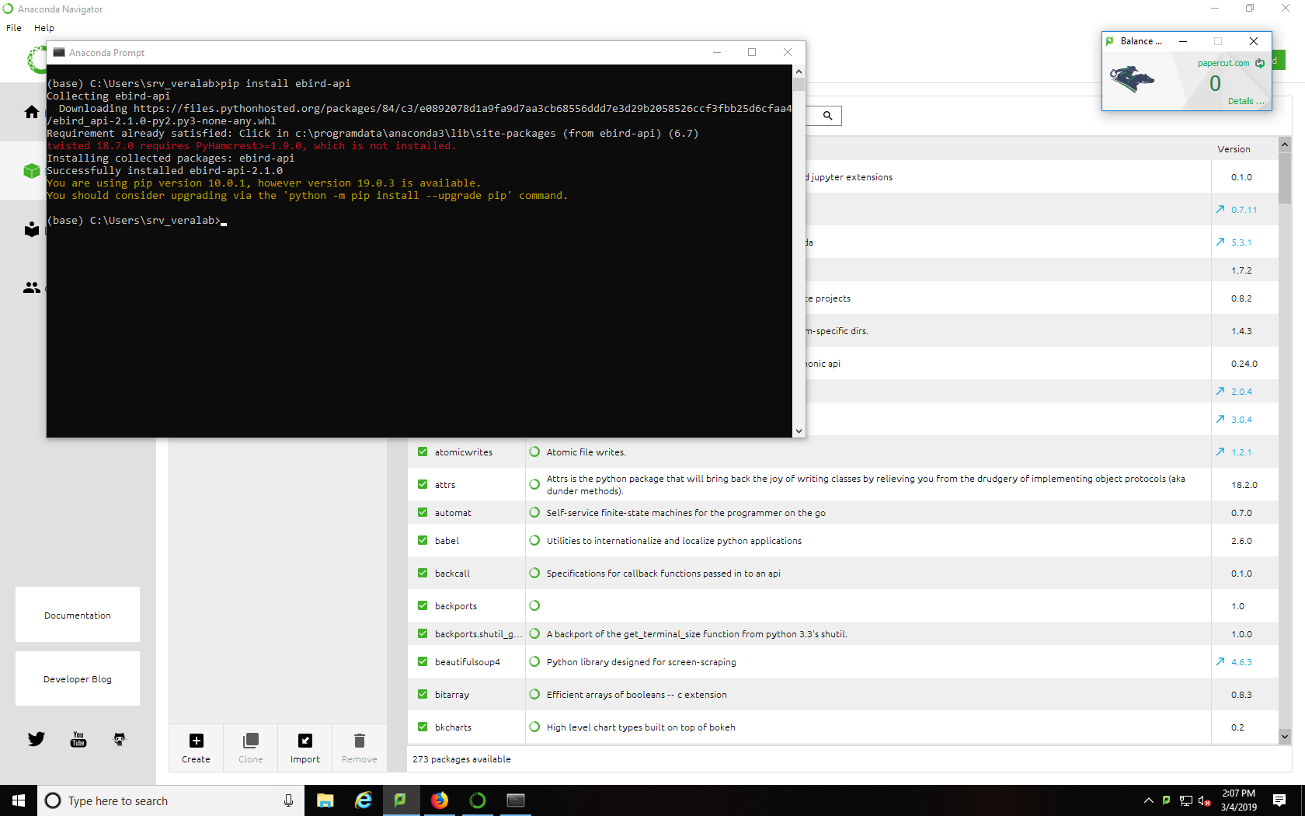

Slide 3
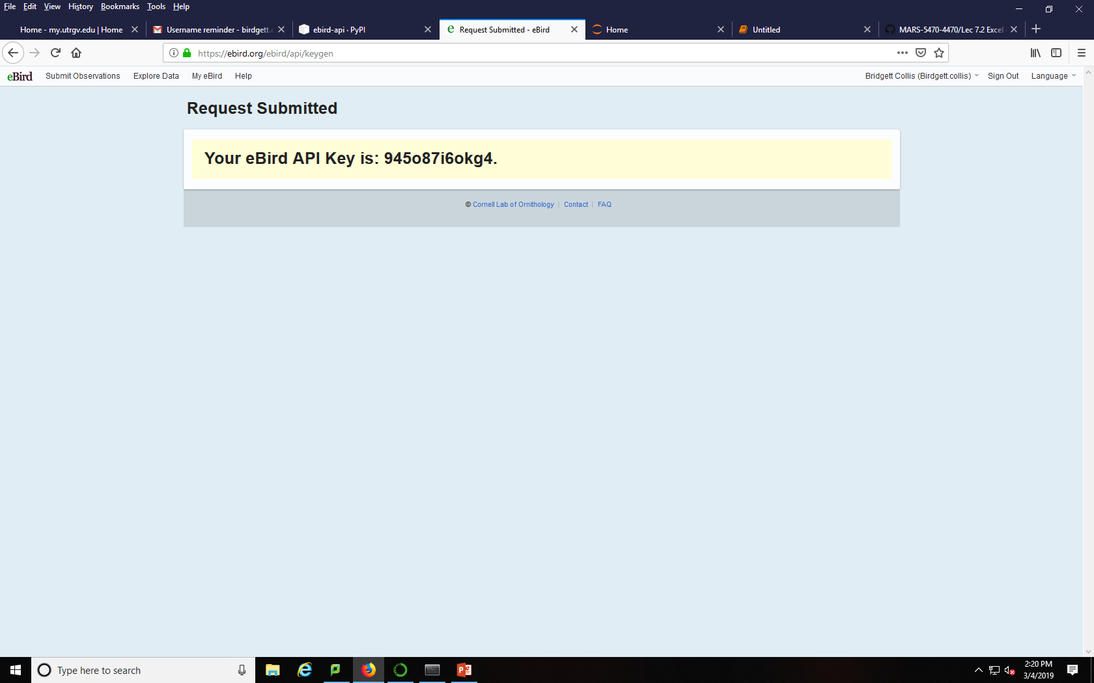

Slide 4
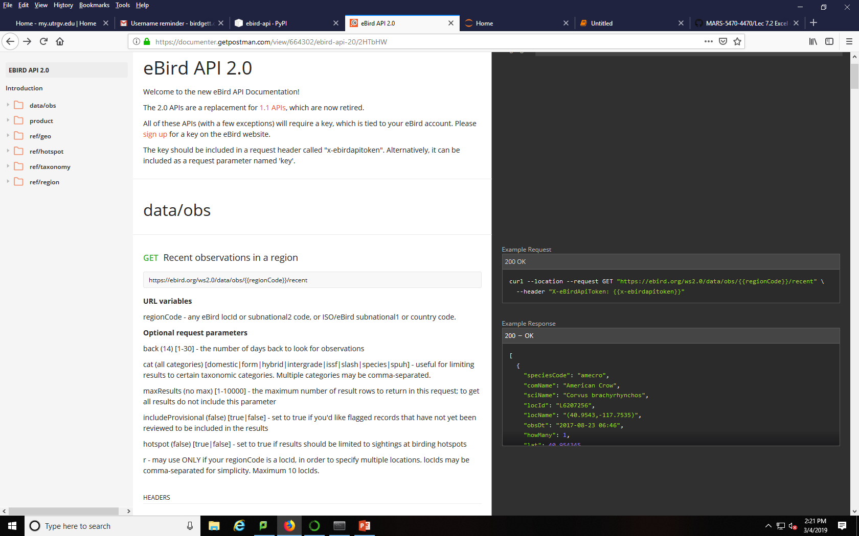

Slide 5
The distribution of a species may be influenced by an array of factors. The set of conditions that allow a species to exist in a geographic area is a representation of the species ecological niche. However, defining these conditions is difficult, due to the complexity of natural systems. One approach to characterizing the ecological niche uses spatial data, GIS software, and modeling algorithms. ecological niche modeling, running maximum entropy. Applications of ecological niche modeling covered in this tutorial included biogeography, conservation biology, disease ecology, macroecology, and invasion biology.
What are the species distributions of a spe

Slide 6
https://github.com/moodycam/MARS-5470-4470/blob/master/Collis/Lec%207.2%20Excel%20continued.ipynb
https://ebird.org/hotspots?hs=L1918641&yr=all&m=
https://pypi.org/project/ebird-api/
https://cornelllabofornithology.github.io/auk/
https://www.crummy.com/software/BeautifulSoup/
https://documenter.getpostman.com/view/664302/ebird-api-20/2HTbHW
http://www.programmingforbiologists.org/lectures/web-data/
https://pypi.org/project/ebird-api/
http://pypi-stats.com/package/?q=ebird-api https://www.dataquest.io/blog/python-api-tutorial/
https://docs.python.org/3/library/json.html http://www.nimbios.org/tutorials/TT_SpatialData2

